Slide 1
Four fields in bibliographic details based on 019 and 035
(Jan. 2020 Release)
Yoel Kortick. Senior Librarian

Slide 2


Introduction
Examples
Results in Analytics

Slide 3
Introduction

Slide 4
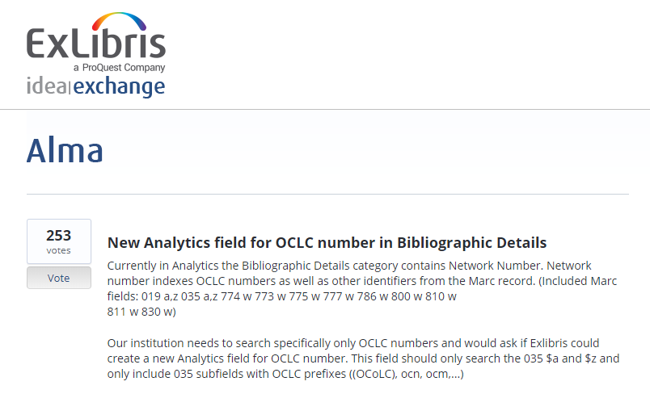
Introduction

Slide 5
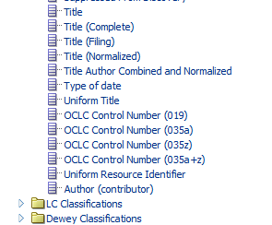
Introduction
Four new fields have been added to the shared folder “Bibliographic Details”

Slide 6
Introduction
OCLC Control Number (019) = The contents of the 019 field
OCLC Control Number (035a) = The contents of the 035 field, only subfield a, when there is an OCLC type prefix
OCLC Control Number (035a+z) = The contents of the 035 field, subfield a and z , when there is an OCLC type prefix
OCLC Control Number (035z) = The contents of the 035 field, only subfield z , when there is an OCLC type prefix

Slide 7
Introduction
In addition to these fields using particular subfields, they are also based on the contents of the prefix in the parentheses.
To be included in the new OCLC fields, the 035 must have an OCLC prefix, such as “(OCLC)” or “(OCoLC)”.
If for example the prefix is “(ABC)” then it will not be included in the new OCLC fields, but will still be included in the older “Network Number” field.
Strings such as ocm are stripped from the result in analytics.

Slide 8
Examples

Slide 9
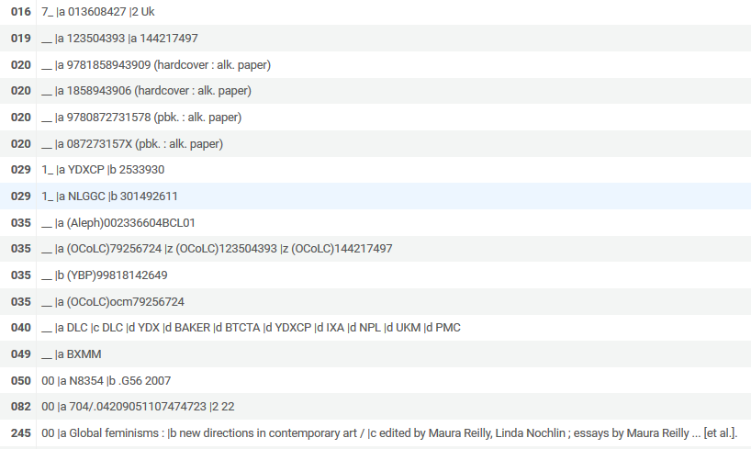
Examples
MMSID 99100372050001021 title “Global feminisms : new directions in contemporary art” appears as follows:
019 with two subfield a
035 with prefix which is not for OCLC
035 with both subfield a and z. Prefix is (OCoLC).

Slide 10
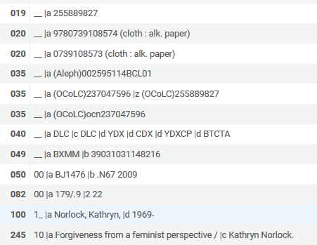
Examples
MMSID 99122086670001021 title “Forgiveness from a feminist perspective” appears as follows:
019 with subfield a
035 with prefix which is not for OCLC
035 with both subfield a and z

Slide 11
Results in Analytics

Slide 12
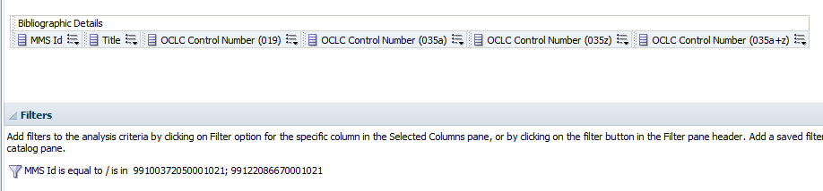
Results in Analytics
Both MMSIDs are retrieved and the new fields are displayed.

Slide 13
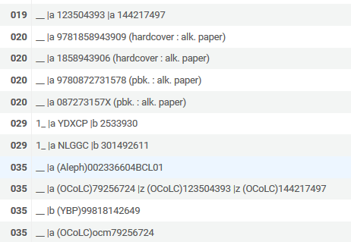
Results in Analytics
This 035 with prefix “(Aleph)” is not included in the new fields

Slide 14
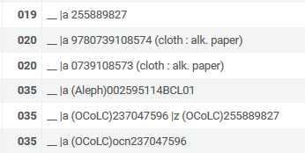
Results in Analytics
The first 035 “(Aleph)002595114BCL01” is not included in the new fields

Slide 15
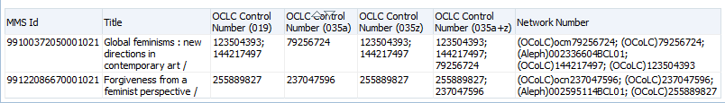
Results in Analytics
Here we can see that “Network Number” includes all 035 fields regardless of the contents of the parentheses in the prefix.
The “Network Number” for example contains
“(Aleph)002336604BCL01” in the first row below but it is not in the OCLC Control Number 035a.
“(Aleph)002595114BCL01” in the second row below but it is not in the OCLC Control Number 035a.

Slide 16
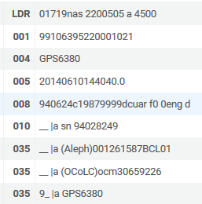
Results in Analytics
Note that a 035 subfield a with value “(OCoLC)ocm30659226” will become Alma Analytics field “OCLC Control Number (035a)” with value “30659226”. The “ocm” is stripped.

Slide 17
Yoel.Kortick@exlibrisgroup.com

